Slide 1
A level Chemistry at King Edward’s School
Welcome to the Chemistry Department
Notes:
Differences between GCSE and A level. Entering lab, lab coats, more risk in practical tasks, more independent, smaller classes, MUST NOT BE AFRAID TO MAKE MISTAKES! Have a go, contribute.

Slide 2
Chemistry at King Edward’s School
The A level course at KES will be taught over two years and examined at the end of your second year. There are no external AS examinations at the end of Year 12 but you will sit an ‘internal’ examination which will give some indication of your aptitude in the subject at that stage. A good performance in this examination may well be a requirement for continued study into Year 13.
You will sit three examination papers at the end of Year 13.
Course breakdown
Examination | Periodic table, elements and physical chemistry (01) | Synthesis and analytical techniques (02) | Unified Chemistry (03)
 | Written Examination | Written Examination | Written Examination
% of final mark | 37% | 37% | 26%
Notes:
3 examinations at end of Year 13, No AS, Questions are A level standard from the start, Paper 1 Physical, Paper 2 Organic, Paper 3 Synoptic.

Slide 3
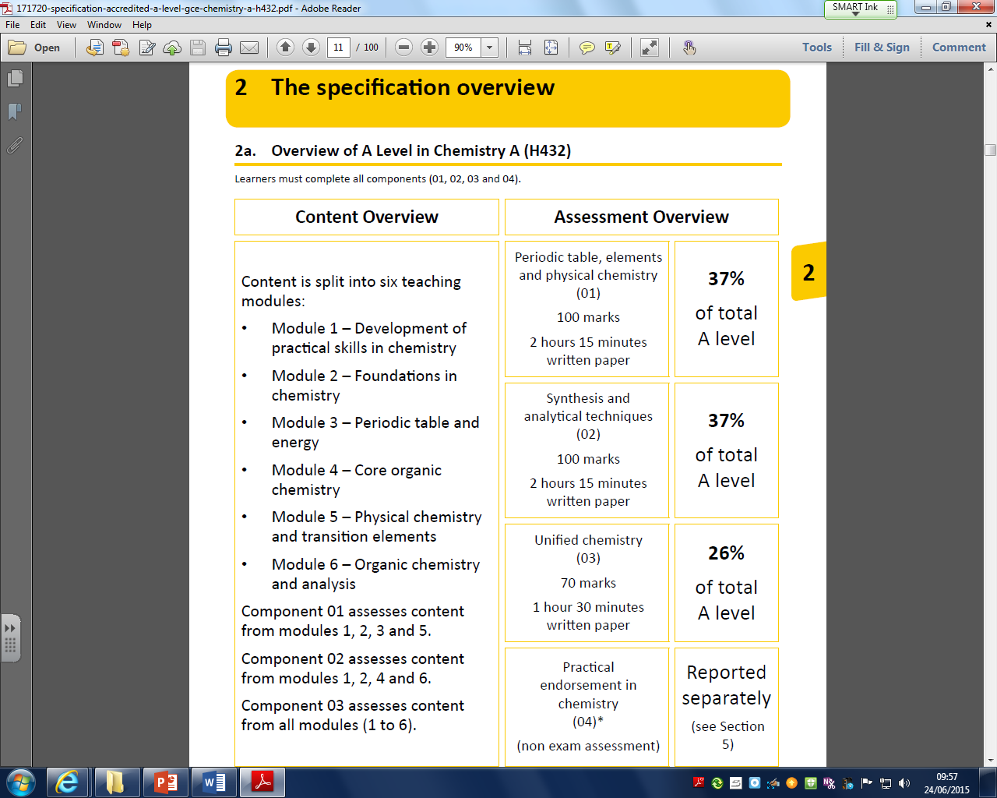
Chemistry at King Edward’s School

Slide 4
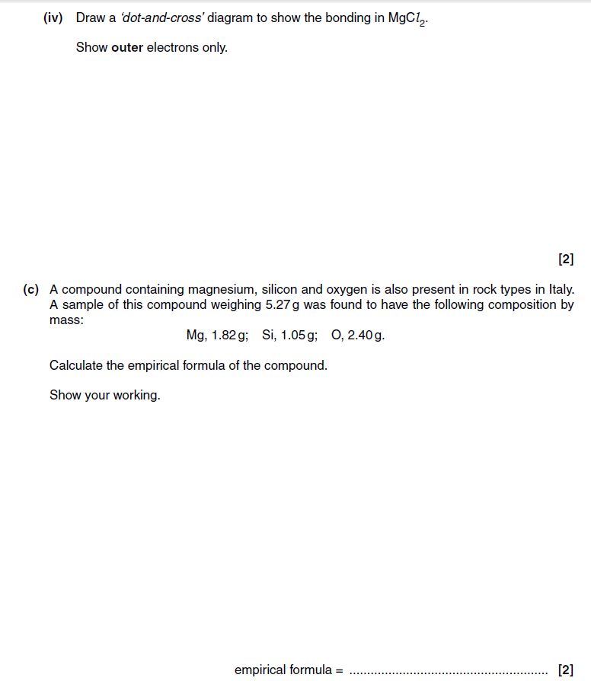
Chemistry at King Edward’s School
Plenty of the work in your first year of A level study will be familiar to you…
Bonding, Moles, Organic, Rates, Chemistry of Group II and VII etc…
The format of the question changes a little, but the theory is the same. You get less structure in the question, instead of a question being broken down into segments it is more common to find the question taking the form of “… tell us everything you know about…”
Notes:
No scaffolding, Tell us everything you know about…, Structure of argument / answer is important = needs order!

Slide 5
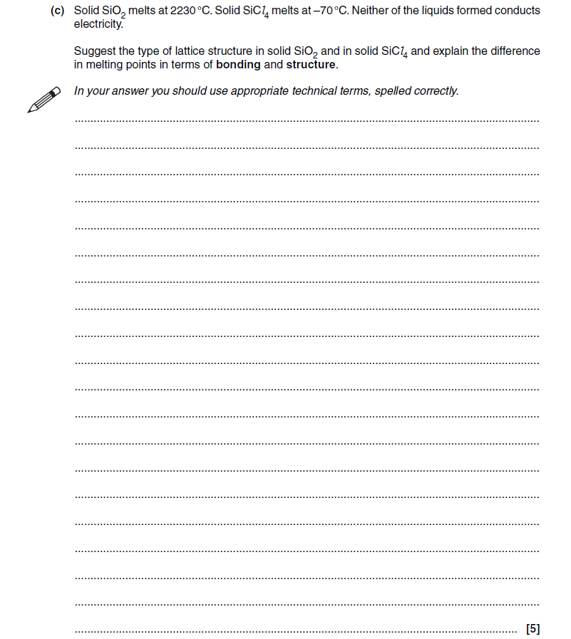
Chemistry at King Edward’s School
This question is pretty much says “… tell us everything you know about covalent structures…”

Slide 6
Chemistry at King Edward’s School
Plenty of changes to… significant differences in terms of:
VOLUME – there is a lot more content – you will need to be very good at learning facts!

Slide 7
Chemistry at King Edward’s School
Plenty of changes to… significant differences in terms of:
VOLUME – there is a lot more content – you will need to be very good at learning facts!
MATHS – more mathematical content – you will need to be very numerate!

Slide 8
Chemistry at King Edward’s School
Plenty of changes to… significant differences in terms of:
VOLUME – there is a lot more content – you will need to be very good at learning facts!
MATHS – more mathematical content – you will need to be very numerate!
PROBLEM SOLVING – much of the work involves applying knowledge to unfamiliar problems – you must be able to think on your feet!

Slide 9
Chemistry at King Edward’s School
Plenty of changes to… significant differences in terms of:
VOLUME – there is a lot more content – you will need to be very good at learning facts!
MATHS – more mathematical content – you will need to be very numerate!
PROBLEM SOLVING – much of the work involves applying knowledge to unfamiliar problems – you must be able to think on your feet!
OPEN TO NEW IDEAS – you can’t rely on the concepts and explanations introduced at GCSE to get you through – we’ve been lying to you!

Slide 10
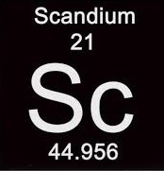
Chemistry at King Edward’s School
Plenty of changes to… significant differences in terms of:
VOLUME – there is a lot more content – you will need to be very good at learning facts!
MATHS – more mathematical content – you will need to be very numerate!
PROBLEM SOLVING – much of the work involves applying knowledge to unfamiliar problems – you must be able to think on your feet!
OPEN TO NEW IDEAS – you can’t rely on the concepts and explanations introduced at GCSE to get you through – we’ve been lying to you!
What is Scandium’s electron arrangement?
Notes:
20 minute introduction at this point to quantum levels / shells, subshells and orbitals, different energy levels, order of filling – try to get them to write the e.c. for Uranium…

Slide 11
ELECTRONIC CONFIGURATIONS
Before you start it would be helpful to…
Know that electrons can be found outside the nucleus in energy levels ( shells)
Know the electronic configurations of the first 20 elements in 2,8,1 notation

Slide 12
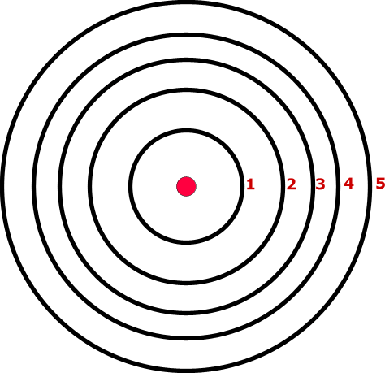
THE BOHR ATOM
Ideas about the structure of the atom have changed over the years. The Bohr theory thought of it as a small nucleus of protons and neutrons surrounded by circulating electrons.
Each shell or energy level could hold a maximum number of electrons.
The energy of levels became greater as they got further from the nucleus and electrons filled energy levels in order.
The theory couldn’t explain certain aspects of chemistry.
Maximum electrons per shell
1st shell 2
2nd shell 8
3rd shell 18
4th shell 32
5th shell 50

Slide 13
LEVELS AND SUB-LEVELS
PRINCIPAL ENERGY LEVELS
During studies of the spectrum of hydrogen it was shown that the energy levels were not equally spaced. The energy gap between successive levels got increasingly smaller as the levels got further from the nucleus. The importance of this is discussed later.
4
3
INCREASING ENERGY / DISTANCE FROM NUCLEUS
2
1

Slide 14
LEVELS AND SUB-LEVELS
PRINCIPAL ENERGY LEVELS
SUB LEVELS
During studies of the spectrum of hydrogen it was shown that the energy levels were not equally spaced. The energy gap between successive levels got increasingly smaller as the levels got further from the nucleus. The importance of this is discussed later.
A study of Ionisation Energies and the periodic properties of elements suggested that the main energy levels were split into sub levels.
Level 1 was split into 1 sub level
Level 2 was split into 2 sub levels
Level 3 was split into 3 sub levels
Level 4 was split into 4 sub levels
4
3
INCREASING ENERGY / DISTANCE FROM NUCLEUS
2
1
CONTENTS

Slide 15
ORBITALS
An orbital is... a region in space where one is likely to find an electron.
Orbitals can hold up to two electrons as long as they have opposite spin; this is known as PAULI’S EXCLUSION PRINCIPAL.
Orbitals have different shapes...

Slide 16
ORBITALS
An orbital is... a region in space where one is likely to find an electron.
Orbitals can hold up to two electrons as long as they have opposite spin; this is known as PAULI’S EXCLUSION PRINCIPAL.
Orbitals have different shapes...
ORBITAL SHAPE OCCURRENCE
s spherical one in every principal level
p dumb-bell three in levels from 2 upwards
d various five in levels from 3 upwards
f various seven in levels from 4 upwards

Slide 17
ORBITALS
An orbital is... a region in space where one is likely to find an electron.
Orbitals can hold up to two electrons as long as they have opposite spin; this is known as PAULI’S EXCLUSION PRINCIPAL.
Orbitals have different shapes...
ORBITAL SHAPE OCCURRENCE
s spherical one in every principal level
p dumb-bell three in levels from 2 upwards
d various five in levels from 3 upwards
f various seven in levels from 4 upwards
An orbital is a 3-dimensional statistical shape showing where one is most likely to find an electron. Because, according to Heisenberg, you cannot say exactly where an electron is you are only able to say where it might be found.
DO NOT CONFUSE AN ORBITAL WITH AN ORBIT

Slide 18
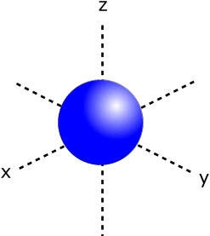
SHAPES OF ORBITALS
s orbitals
spherical
one occurs in every principal energy level

Slide 19
SHAPES OF ORBITALS
p orbitals
dumb-bell shaped
three occur in energy levels except the first

Slide 20
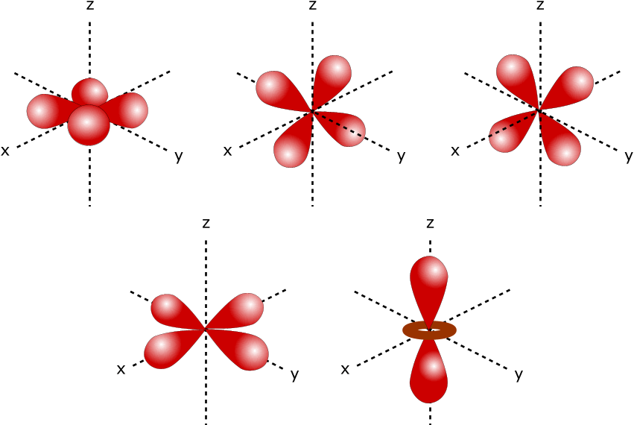
SHAPES OF ORBITALS
d orbitals
various shapes
five occur in energy levels except the first and second

Slide 21
ORDER OF FILLING ORBITALS
PRINCIPAL ENERGY LEVELS
SUB LEVELS
4f
4
4d
4p
4s
3d
3
3p
3s
INCREASING ENERGY / DISTANCE FROM NUCLEUS
2
2p
2s
1
1s
Orbitals are not filled in numerical order because the principal energy levels get closer together as you get further from the nucleus. This results in overlap of sub levels. The first example occurs when the 4s orbital is filled before the 3d orbitals.

Slide 22
ORDER OF FILLING ORBITALS
PRINCIPAL ENERGY LEVELS
SUB LEVELS
PRINCIPAL ENERGY LEVELS
SUB LEVELS
4f
4f
4
4d
4
4d
4p
4p
4s
3d
4s
3d
3
3p
3
3p
3s
3s
INCREASING ENERGY / DISTANCE FROM NUCLEUS
2p
2
2
2p
2s
2s
1
1s
1
1s
Orbitals are not filled in numerical order because the principal energy levels get closer together as you get further from the nucleus. This results in overlap of sub levels. The first example occurs when the 4s orbital is filled before the 3d orbitals.

Slide 23
ORDER OF FILLING ORBITALS
PRINCIPAL ENERGY LEVELS
SUB LEVELS
PRINCIPAL ENERGY LEVELS
SUB LEVELS
4f
4f
4d
4d
HOW TO REMEMBER ...
4
4
4p
4p
4s
3d
4s
THE FILLING ORDER
1s
2s 2p
3s 3p 3d
4s 4p 4d 4f
5s 5p 5d 5f
6s 6p 6d
7s 7p
3d
3
3p
3
3p
3s
3s
INCREASING ENERGY / DISTANCE FROM NUCLEUS
2p
2
2
2p
2s
2s
1
1s
1
1s
Orbitals are not filled in numerical order because the principal energy levels get closer together as you get further from the nucleus. This results in overlap of sub levels. The first example occurs when the 4s orbital is filled before the 3d orbitals.

Slide 24
Chemistry at King Edward’s School
How would we write the s,p,d and f notation for Scandium?

Slide 25
Chemistry at King Edward’s School
How would we write the s,p,d and f notation for Scandium?
1s² 2s² 2p⁶ 3s² 3p⁶ 4s² 3d¹

Slide 26
Chemistry at King Edward’s School
How would we write the s,p,d and f notation for Scandium?
1s² 2s² 2p⁶ 3s² 3p⁶ 4s² 3d¹
How would we write the s,p,d and f notation for Rubidium?

Slide 27
Chemistry at King Edward’s School
How would we write the s,p,d and f notation for Scandium?
1s² 2s² 2p⁶ 3s² 3p⁶ 4s² 3d¹
How would we write the s,p,d and f notation for Rubidium?
…….. 3d¹⁰ 4s¹

Slide 28
Chemistry at King Edward’s School
How would we write the s,p,d and f notation for Scandium?
1s² 2s² 2p⁶ 3s² 3p⁶ 4s² 3d¹
How would we write the s,p,d and f notation for Rubidium?
…….. 3d¹⁰ 4s¹
Now give the s,p,d and f notation for Uranium….

Slide 29
Chemistry at King Edward’s School
Plenty of changes to… significant differences in terms of:
VOLUME – there is a lot more content – you will need to be very good at learning facts!
MATHS – more mathematical content – you will need to be very numerate!
PROBLEM SOLVING – much of the work involves applying knowledge to unfamiliar problems – you must be able to think on your feet!
OPEN TO NEW IDEAS – you can’t rely on the concepts and explanations introduced at GCSE to get you through – we’ve been lying to you!
PRACTICALLY COMPETENT – your skills need to improve and you need to work independently!

Slide 30
Chemistry at King Edward’s School
There is also the practical endorsement in chemistry, and while it is not an examined component, you will be required to show significant progression in your practical skills in order to ‘pass’ this element of the course. A significant percentage of the questions in all three papers will require good knowledge of practical techniques and procedures. The component is continually assessed by your teachers and takes place throughout the two year A level course.

Slide 31
Chemistry at King Edward’s School
5 Key Skill Areas
Follows written procedures
Applies investigative approaches and methods when using instruments and equipment
Safely uses a range of practical equipment and materials
Makes and records observations
Researches, references and reports
Notes:
Discuss PAG books, write ups, endorsement and then 20 minute practical. Do not help them…! They can follow instruction
Answers on next slide.

