Slide 1
A Level
Computer Science
Pre course Questionnaire:https://forms.office.com/r/EAtQwwP9sW

Slide 2
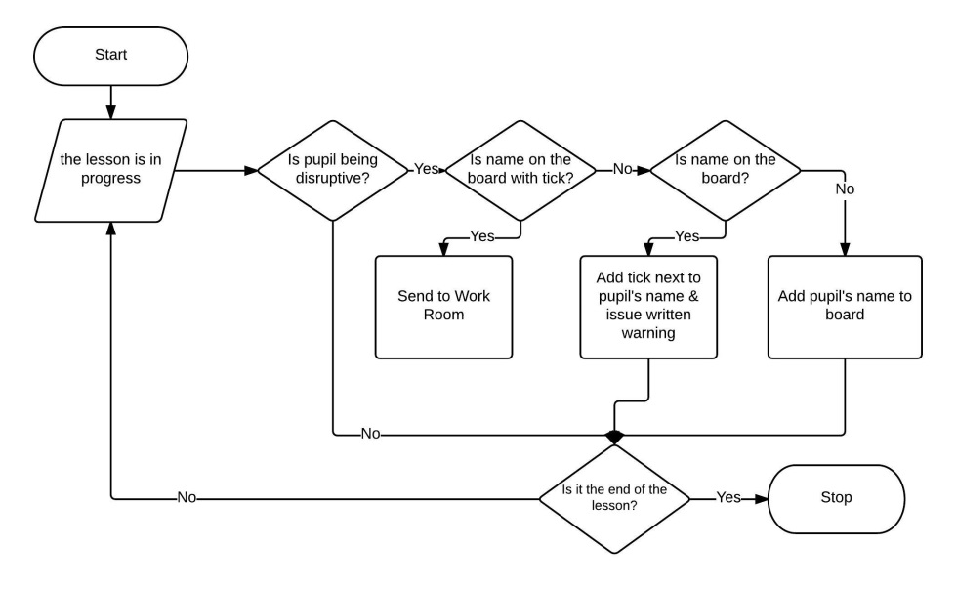
What is Object Oriented Programming?
So far you have used Procedural Programming
Object Oriented Programming (OOP) imitates real life more by developing the concept of objects
WHILE lesson in progress
IF pupil is disruptive then
IF pupil name on board and name has tick then
send to work room
ELSE IF pupil name on board
add tick to name
issue written warning
ELSE
add name to board
issue verbal warning
END IF
END IF
END WHILE

Slide 3
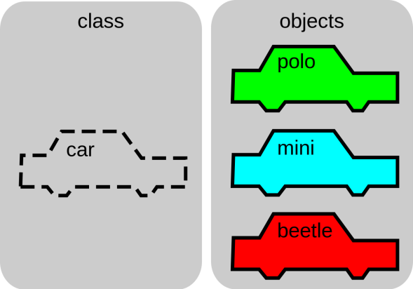
Objects
Objects are used as a way of expressing a real world entity in programming form
think of them as a "super variable" with added functions
makes them easier to understand by other programmers
contain properties (data about the object)
and methods (actions the object can do)
Think of other Properties of a car
Think of other Methods of a car

Slide 4
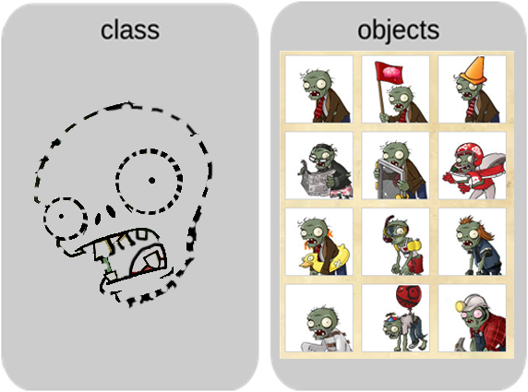
Classes & Objects
Classes are the blueprints for creating objects
Once created, each object is separate from each other.
they are similar but behave separately and have different properties (alive/ dead /colour / name)
imagine enemies in a computer games!
What properties & methods might a Zombie class have in Plants vs Zombies?

Slide 5
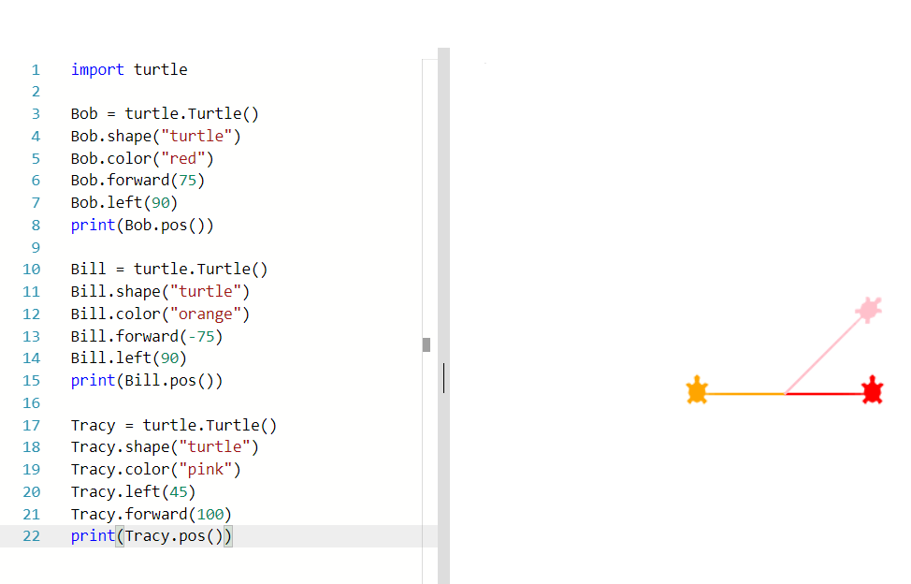
Example with Turtles
The Turtle class already exists in Python
What are the names of the 3 objects
Can you name a property of a Turtle class?
Can you name a method of a Turtle class?
Why does one Turtle go diagonally?
We like https://replit.com/ as its an online IDE for most programming languages
Now try adding your own Turtle object to create a pattern
https://replit.com/@laurajamesBCS/ThreeTurtles

Slide 6
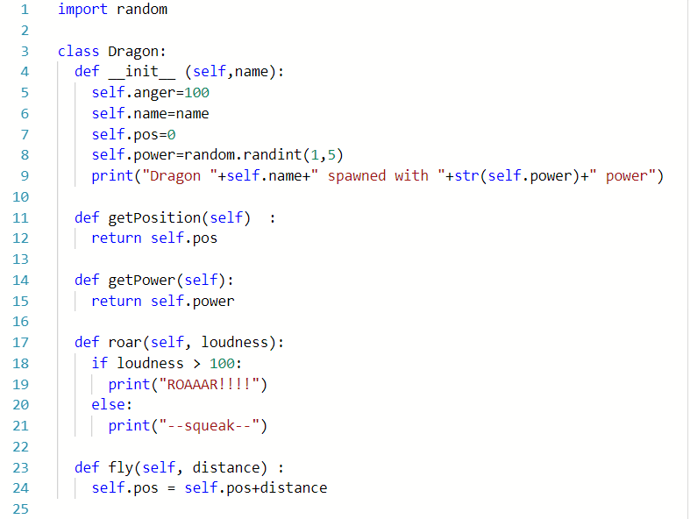
Building your own classes
properties
constructor
methods
class
https://replit.com/@laurajamesBCS/KnightsVsDragons

Slide 7
Task: Create an object ... and a new class
You've created a new Class but how do you create an object from it?
Python code
Output
Creating an object from a class is called instantiation

Slide 8
Creating an object from your new Class
Use the skeleton code provided to
Create your own Dragon object
Test it by running the code a few times
Try running the fly() method followed by the getPosition() method
Extension
Try to make your own class – e.g. Knight -
Can you make the Knight have a method called fight(dragon)?
https://replit.com/@laurajamesBCS/KnightsVsDragons

Slide 9
Importing a class from another file
from Knight import Knight

