Slide 1
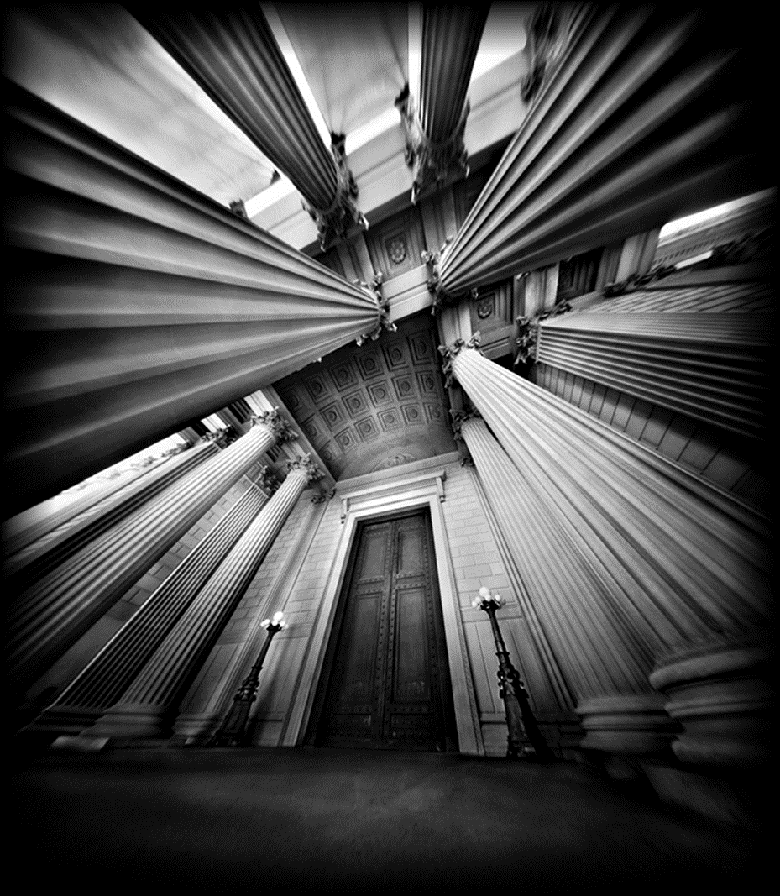
A Level Photography King Edwards School

Slide 2
AQA A Level Art & Design- Photography
3.8 Photography
Students should be introduced to a variety of experiences that explore a range of photographic media, techniques and processes. They should be made aware of both traditional and new technologies.
Students should explore relevant images, artefacts and resources relating to a range of art, craft and design, from the past and from recent times, including European and non-European examples. This should be integral to the investigating and making processes. Students' responses to these examples must be shown through practical and critical activities that demonstrate their understanding of different styles, genres and traditions.
Students should use sketchbooks/workbooks/journals to underpin their work where appropriate. They may wish to develop their drawing skills in order to produce storyboards, thumbnail sketches and/or diagrams, where appropriate.
Students may use traditional methods and/or digital techniques to produce images.
Students should be aware of the four assessment objectives to be demonstrated in the context of the content and skills presented and of the importance of process as well as product.
Areas of study
Students are required to work in one or more area(s) of Photography, such as those listed below. They may explore overlapping areas and combinations of areas:
portraiture
landscape photography (working from the urban, rural and/or coastal environment)
still life photography (working from objects or from the natural world)
documentary photography, photojournalism
fashion photography
experimental imagery
multimedia
photographic installation
moving image (video, film, animation).

Slide 3
Skills and techniques
Students will be expected to demonstrate skills, as defined in Overarching knowledge, understanding and skills, in the context of their chosen area(s) of Photography. Students will be required to demonstrate skills in all of the following:
the ability to explore elements of visual language, line, form, colour, pattern and texture in the context of Photography
awareness of intended audience or purpose for their chosen area(s) of Photography
the ability to respond to an issue, theme, concept or idea, or work to a brief or answer a need in Photography
appreciation of viewpoint, composition, aperture, depth of field, shutter speed and movement
appropriate use of the camera, film, lenses, filters and lighting for work in their chosen area(s) of Photography
understanding of techniques related to the production of photographic images and, where appropriate, presentation and layout.
Knowledge and understanding
Students must show knowledge and understanding of:
relevant materials, processes, technologies and resources
how ideas, feelings and meanings can be conveyed and interpreted in images and artefacts created in their chosen area(s) of Photography
historical and contemporary developments and different styles and genres
how images and artefacts relate to social, environmental, cultural and/or ethical contexts, and to the time and place in which they were created
continuity and change in different styles, genres and traditions relevant to Photography
a working vocabulary and specialist terminology that is relevant to their chosen area(s) of Photography.

Slide 4
A-level
Assessments
Component 1: Personal investigation
What's assessed Personal investigation - 7201/C, 7202/C, 7203/C, 7204/C, 7205/C, 7206/C
Assessed No time limit 96 marks 60% of A-level
Non-exam assessment (NEA) set and marked by the centre and moderated by AQA during a visit to the centre. Visits will normally take place in June.
Component 2: Externally set assignment
What's assessed Response to an externally set assignment - 7201/X, 7202/X, 7203/X, 7204/X, 7205/X, 7206/X
Assessed Preparatory period + 15 hours supervised time 96 marks 40% of A-level
Non-exam assessment (NEA) set by AQA, marked by the centre and moderated by AQA during a visit to the centre. Visits will normally take place in June.

Slide 5
Component details
Component 1 Personal investigation
This is a practical investigation supported by written material.
Students are required to conduct a practical investigation, into an idea, issue, concept or theme, supported by written material. The focus of the investigation must be identified independently by the student and must lead to a finished outcome or a series of related finished outcomes.
The investigation should be a coherent, in-depth study that demonstrates the student’s ability to construct and develop a sustained line of reasoning from an initial starting point to a final realisation.
The investigation must show clear development from initial intentions to the final outcome or outcomes. It must include evidence of the student’s ability to research and develop ideas and relate their work in meaningful ways to relevant critical/contextual materials.
The investigation must be informed by an aspect of contemporary or past practice of artists, photographers, designers or craftspeople.
The written material must confirm understanding of creative decisions, providing evidence of all four assessment objectives by:
clarifying the focus of the investigation
demonstrating critical understanding of contextual and other sources
substantiating decisions leading to the development and refinement of ideas
recording ideas, observations and insights relevant to intentions by reflecting critically on practical work
making meaningful connections between, visual, written and other elements.
The written material must:
be a coherent and logically structured extended response of between 1000 and 3000 words of continuous prose.
include specialist vocabulary appropriate to the subject matter
include a bibliography that, identifies contextual references from sources such as: books, journals, websites, through studies of others’ work made during a residency, or on a site, museum or gallery visit
be legible with accurate use of spelling, punctuation and grammar so that meaning is clear.

Slide 6
Students can present the written material as a single passage of continuous prose or as a series of shorter discrete, but linked, passages of continuous prose incorporated within the practical work.
There is no restriction on the scale of practical work produced. Students should carefully select, organise and present their work for their Personal investigation to ensure it is well structured and provides evidence that meets the requirements of all four assessment objectives.
The personal investigation will be assessed as a whole. Evidence of meeting the requirements of all four assessment objectives must be provided in both the practical and written material. Please refer to Assessing the Personal investigation of the specification for more information on how to assess the Personal investigation.
Students must identify and acknowledge sources which are not their own.
Component 2 Externally set assignment
Separate question papers will be provided for each title. Each question paper will consist of a choice of eight questions to be used as starting points. Students are required to select one. Students will be provided with examination papers on 1 February, or as soon as possible after that date.
Preparatory period – from 1 February
Following receipt of the paper students should consider the starting points and select one. Preparatory work should be presented in any suitable format, such as mounted sheets, design sheets, sketchbooks, workbooks, journals, models and maquettes.
Supervised time – 15 hours
Following the preparatory period, students must complete 15 hours of unaided, supervised time.
The first 3 hours of the supervised time must be consecutive.
In the 15 hours students must produce a finished outcome or a series of related finished outcomes, informed by their preparatory work.
Students must stop work on their preparatory work as soon as the first period of supervised time starts. Students may refer to their preparatory work in the supervised time, but it must not be added to or amended.

Slide 7
Preparatory work and the work produced during the supervised time must be kept secure in between sessions of supervised time.
The work produced during the supervised time must be clearly identified as such. Students must identify and acknowledge sources which are not their own. Annotation and/or notes should use appropriate specialist vocabulary and be legible with accurate use of language so that meaning is clear.
At the end of the 15 hours of supervised time all the work submitted for this component must be kept secure.
Preparatory work and the work produced during the 15 hours of supervised time will be assessed together, as a whole, against all four assessment objectives. Students will be assessed on their ability to work independently, working within the specified time constraints, and developing a personal and meaningful response.
There is no restriction on the scale of work produced. Students should carefully select, organise and present work to ensure that they provide evidence which meets the requirements of all four assessment objectives.
The guidelines set out in the JCQ document ‘Instructions for the conduct of examinations’ must be followed.

Slide 8
A level Photography Course Structure
Year 12
Key Skills & Techniques throughout the Autumn and Spring Term
Autumn Term
Introduction to Photography, techniques and process using the digital and film cameras
Introduction to the Darkroom, Photograms and BW film
Multi-Media, Collage & Experimental techniques
Artist Links; Man Ray, Anna Atkins, John Herschel, Justin Quinnell, Edward Steichen, Raoul Hausmann, Hannah Hoch, Christopher Russell.
Camera Management: Exposure& Composition
Artist Links; Ernst Haas, Phillipe Hausmann, Matthew Pilsbury, Matthew Fang
Spring Term
Studio: Still Life, Portraiture, Lighting & Projection
Photoshop Techniques
BW Film
Artist Links; Olivia Parker, Scottie Cameron, Raphael Dallaporta, Laura Latinsky, Edward Weston, Irving Penn, Imogen Cunningham, David Bailey, Jane Brown, Nick Knight, Horst P Horst, Rankin, John French
**ResidentialTrip**
Summer Term
You will continue to have regular workshop lessons whereby new techniques and processes will be introduced to you. Alongside this you will need to begin your Personal Investigation.
You will choose one of the following themes as a starting point for your coursework. This will comprise of a final piece of work and a written element. The written element is essential and will follow a diary approach, enabling you to accurately document the processes and inspirations as the project develops.

Slide 9
Students are required to work in one or more area(s) of Photography, such as those listed below. They may explore overlapping areas and combinations of areas:
portraiture
landscape photography (working from the urban, rural and/or coastal environment)
still life photography (working from objects or from the natural world)
documentary photography, photojournalism
fashion photography
experimental imagery
multimedia
photographic installation
moving image (video, film, animation).
Your teacher will provide you with handouts on how to structure your written part of the Personal Investigation.
Year 13
Autumn Term- Spring Term (Feb)
You will continue to work on and complete your Personal Investigation.
Spring Term (Feb)
You will be issued with your Exam paper. Key concerns that should be addressed include:
CHOICE OF QUESTION
Take advice from staff, work to your strengths, and do not feel that you have to do something radically new.
Choose a theme that can be easily resourced and researched locally.
Be enthused and passionate about the subject matter.
Don’t be afraid to re-visit a theme you have explored before.
Finding relevant photographer links is vital. Explore local galleries, museums and locations/environments.
Consider the potential of the overseas tour. Do some research regarding locations, photographers etc., as this will be a major resource /inspiration gathering time.

Slide 10
TECHNIQUE AND PROCESS
Begin with some first-hand observations.
Use different techniques at this stage, ranging from dark room through to digital.
Experiment and take visual risks at this stage rather than later on.
Experience and investigate working on a range of scales.
Sketchbooks and IDEAS sheets should become rich, annotated visual documents and clearly demonstrate your thinking and development.
Once you have decided upon your materials practice and produce trial studies. All technical and aesthetic concerns should be solved before the exam.
THE FINAL PIECE
Be ambitious, creative, imaginative. Look for the WOW factor!!
The final piece must be well planned and beautifully crafted and presented.
The outcome should be a logical conclusion to your research.
Plan and ‘time manage’ each slot, setting specific targets. Be prepared to review and re-focus.
***CONSTANTLY REFER TO THE ASSESSMENT OBJECTIVES!!***

Slide 11
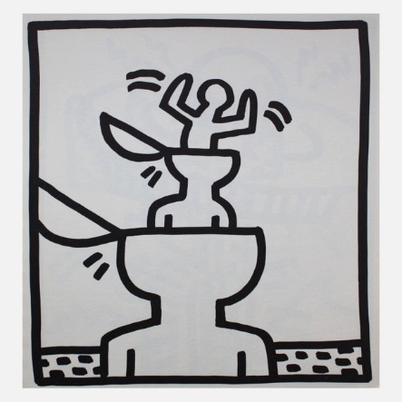
C R E A T E
COLLECT REVIEW EXPLORE ASSESS TARGET EVALUATE
Students are to take ownership of this process.
Aims:
To evaluate progress and to review and refine approach.
To assess levels of achievement (Against AO’s for exam groups)
To set goals/targets and highlight areas to improve.
To promote enjoyment and understanding of the subject
To encourage ownership and responsibility.

Slide 12
PHOTOGRAPHY MANTRA!
An aid to producing quality photography on a regular basis.
The photographer should ask questions of themselves before they start creating images, this critical reflection should continue during the making process and as a part of the assessment process.
Begin with the understanding that the photographer takes full responsibility for their photographs.
You must take OWNERSHIP. The creative process begins here!
WHAT AM I GOING TO CAPTURE/CREATE? What is my theme/subject?
WHY AM I FOCUSING ON THIS SPECIFIC SUBJECT? Could be Passion, love, interest, knowledge, the only option.
HOW AM I GOING TO PRODUCE THE IMAGE? WHAT TECHNIQUE, APPROACH, STYLE? HOW, SHOULD BE DICTATED BY YOUR AIMS. (e.g. I am trying to capture the colour.)
GATHER APPROPRIATE RESOURCES. FIRST AND SECOND HAND. KEEP ADDING TO AND ENRICHING THESE RESOURCES.
BEGIN MAKING.
RESPOND TO WHAT YOU HAVE MADE AND MOVE FORWARDS.
CONSTANTLY ASSESS AND REFLECT ON YOUR PROGRESS.
This whole process is cyclical and will move at a different pace depending on the individual.
‘YOU DON’T TAKE A PHOTOGRAPH, YOU MAKE IT’
Ansel Adams.
This whole process cannot just take place in lessons; you need to become fascinated and fully involved in your work. If you have no interest in your work why should anyone else?

Slide 13
HEALTH AND SAFETY POLICY
ART, DESIGN & PHOTOGRAPHY
GUIDELINES
The following guidelines are to be applied throughout the department.
Studios and storeroom to be locked between and after lessons. (Some sixth form access). Pupils can only work/enter studios with staff permission.
Blazers, bags etc. to be left outside studio spaces. Long hair tied back. Aprons worn.
No food and drink to be consumed in studio space.
Movement around the studios must be orderly and calm. No running.
Start, and end, of lessons to be structured and studios to be left tidy and ordered.
Clear instruction and demonstrations must be given with tools, machinery etc.
Appropriate precautions and protection must be adopted with different materials.
Staff must be aware of any student Health or Behavioural issues. (SRN Policy)
Normal KES Fire and evacuation guidelines apply.
First aid issues to be referred to Medical centre.
Studio space to be kept tidy and organised.
No tools, knives etc. to be removed from the department.

